Slide 1
Common Core Connections Project
ECI 545 Theory and Research in Literacy
Presented by: Amanda Ricketts & Latoria Felder

Slide 2
Common Core Standards
RI.1.8- Identify the reasons an author gives to support points in a text
RI.1.9- Identify basic similarities in and differences between two texts on the same topic.
RI.1.5- Know and use various text features to locate key facts or information in a text.
RI.1.1- Ask and answer questions about key details in text.
SL.1.1- Participate in collaborative conversations with diverse partners about grade 1 topics and texts with peers and adults in small and larger groups.
SL.1.2- Ask and answer questions about key details in a text read aloud or information presented orally or through other media.

Slide 3
Lesson Focus
Identify the reasons an author gives to support points in a text
Identify basic similarities and differences between two texts on the same topic
Know and use various text features to locate key facts or information in a text
Ask and answer questions about key details in text

Slide 4
Choices of Text Complexity Progression
Goats Are Great!
Level H Books
Ages
6 - 7
Grade
1
Lexile
80-450
Shelter Pets Are Best
Level P Books
Ages
7 - 8
Grade
2
Lexile
601-650

Slide 5
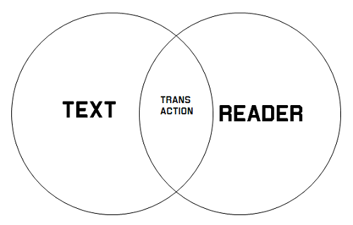
Connections To Literacy Theories
Transactional/Reader Response Theory
2 types of responses that readers have to text:
Efferent responses: which are fact-oriented and may require readers to pull answers from literature, draw conclusions, and generate opinions.
Aesthetic responses: which are more personally and emotionally based, and may ask the readers to communicate what they felt, how something may have looked, etc.

Slide 6
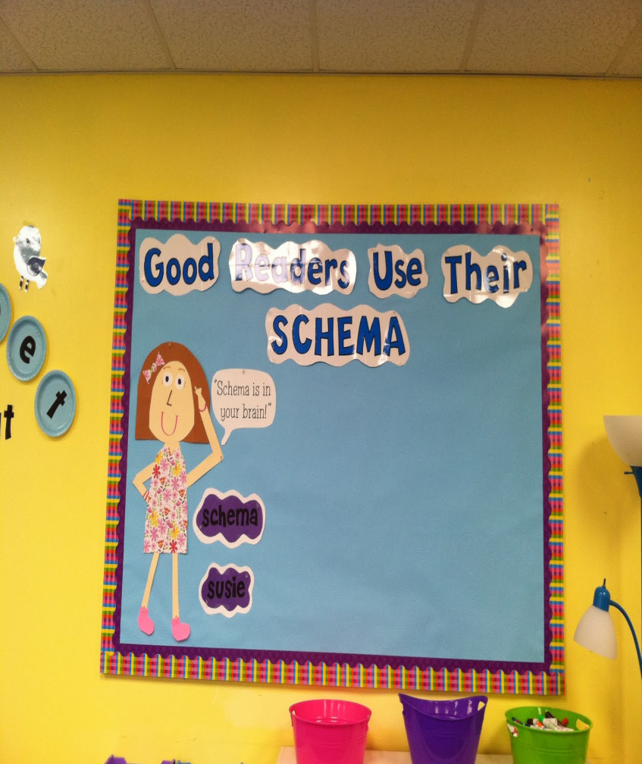
Connections to Literacy Theories
Schema Theory-becomes theories about reality.
-Knowledge is organized into units. Within these units of knowledge, or schemata, is stored information.
-Represents knowledge about concepts: objects and the relationships they have with other objects, situations, events, sequences of events, actions, and sequence of actions.

Slide 7

Connections To Literacy Theories
Meta-Cognitive Theory
“thinking about thinking”
“successful text comprehension involves metacognition-the active management of meaning creation through a process of mediation between reader, text, and context factors” (Allen & Hancock, p.125) ~ from Lenses of Reading book

Slide 8
Video Clips of Scaffolding Strategies
Amanda
http://www.youtube.com/watch?v=o6b7NpVlaBY&feature=youtu.be

Slide 9
Video Clip of Scaffolding Strategies
Latoria
http://prezi.com/9934nvgoivsx/ccc-project/?kw=view-9934nvgoivsx&rc=ref-4703204

Slide 10
Video Clip of Text-Based Questioning
Amanda
http://www.youtube.com/watch?v=wdkXEJZEoaI

Slide 11
Questions!?

