Slide 1
Harlem Children’s Zone
Called "one of the most ambitious social-service experiments of our time," by The New York Times

Slide 2
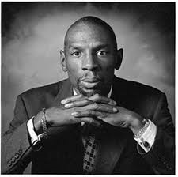

Slide 3
Geoffrey Canada’s Thoughts on HCZ
http://www.youtube.com/watch?v=1H0k2TDZF7o

Slide 4
Who, What, When, Where…
Who: Geoffrey Canada (Came from where these children/families have been.)
What: Program that helps the poor families with school and a variety of programs.
When: 1970’s – Present
Where: Harlem (Over 100 blocks)

Slide 5
The Beginning
HCZ began in the 1970’s as Geoffrey Canada working with young children and families.
They first started with one block in Harlem of children that suffered from terrible circumstances- crumbling apartments, falling schools, violent crimes, health problems, etc. (1970)
By 1990, HCZ expanded from one block to working a 24 block area.

Slide 6
Growing and What it does for the Community:
2007 HCZ grew to 100 blocks!! It now serves over 8,000 children and 6,000 adults.
Some programs HCZ offers to children and adults:
Baby College (Parenting workshops)
Harlem Gems (Preschool Program)
HCZ Asthma Initiative (Teaches families how to better manage diseases)
Promise Academy (High quality charter school)
Obesity Program (Helps kids stay fit)
All of these programs bring communities together and want to all work together (including staff) to help these families get the help and life they deserve.

Slide 7
The Children’s Zone Model
The five principles of the HCZ to create CHANGE:

Slide 8
5 Principles
Principle 1: Neighborhood-Based, At-Scale Approach
While no single non-profit organization can meet the needs of the millions of American children living in poverty, one organization working with partners can make a difference for thousands of children in one community.
HCZ focuses on finite area where the program can concentrate on intensive services with children and families that are hardest to reach.
HCZ surrounds children and families with programs and role models whose message is success. (Religion, schools, weight control, college preparation, etc.)

Slide 9
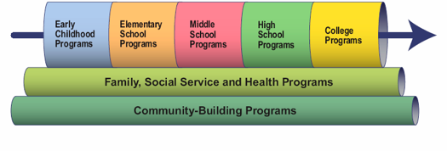
Principle 2: The HCZ Pipeline
The HCZ Pipeline is a continuum of services that are seamless series of free, coordinated, best-practice programs. We focus on the needs of children at every developmental stage with specific programs addressing pre-natal care, infants, toddlers, elementary school, middle school, adolescents, and college.
Academic excellence is a PRIMARY goal of the HCZ Pipeline.
Children/Adults can enter this pipeline at any stage and will be supported with all of the high-quality programs.

Slide 10
Principle 2 Continued…
Overall with the Pipeline, HCZ seeks to:
1. Maximize educational achievements for poor children.
2. Ensure that each of the programs in the pipeline is strong and incorporates best practices.
3. Foster strong links across programs to smooth transitions and guarantee that programs are pedagogically continuous.
4. Stay community-based and responsive to local community needs and
5. Provide relevant data to program staff so that they can improve services, and to policymakers and decision-makers so that they can get the best return on their investments.
Each of the HCZ programs have been developed to work with poor children and families.
HCZ Pipeline programs consistently produce outcomes that meet or exceed national, state, and city averages.

Slide 11
Principle 3: Building Community
HCZ believes that it takes an entire community to help each other grow and improve internally and externally.
Through leadership, community organizing, neighborhood beautification, connections to social services, and a host of other activities, the program works every day to build a strong community and mend the fabric of Central Harlem.
The “community” for HCZ is defined as: thoughtful local residents, stakeholders, and local institutions that will in the end sustain the ENTIRE community.

Slide 12
Principle 4: Evaluation
Evaluation is a key part of everything the program is at HCZ. It provides managers with real-time decision-making data and drives program improvements.
HCZ constantly uses it as a critical tool in a process of continuous self-examination and improvement.
After each year, HCZ gets together and makes changes to the current evaluation that is set by mentors, evaluators, current families or children.

Slide 13
Principle 5: Culture of Success
HCZ’s organizational culture emphasizes accountability, leadership, teamwork, and a deep, shared passion to improve the lives of poor children
Staff members consider it a privilege to work for HCZ in the interest of Harlem’s children.
HCZ is extremely ambitious in their goals and determined to meet them. They believe and work wholeheartedly to ensure that all our children will succeed. The only way to do this is with a motivated, dedicated, highly-trained staff working together with a common purpose.
Interviewees go through strenuous applications/questions in order to be hired to work with our families.

Slide 14
Principle 5 Continued
Core Values: HCZ staff share a passion for helping children and families and placing children at the core of their work; maintaining high standards for themselves, their colleagues, and their clients; holding themselves and others accountable for outcomes; connecting with the community; and upholding the highest ethics in their lives and work.
Leadership: Leaders at HCZ share some general characteristics, including a strong and intense work ethic, the ability to self-manage and to acknowledge mistakes, a can- do/make-it-happen attitude, personal effectiveness, and a professional manner.

Slide 15
HCZ’s Origin Aim
HCZ’s aims are both broadly ambitious and sharply focused. The program seeks to touch virtually every developmentally important aspect of our children’s lives as they grow to adulthood. But they do not take sole responsibility for every economic and social problem faced by every child and family. Instead, HCZ attempts to create a community of self-reliant families working together to build a common future through their own best efforts.

Slide 16
For children to do well, families have to do well. For families to do well, communities have to do well.

Slide 17
Harlem Children’s Zone strives to achieve and assure that…
Children are healthy and prepared for school entry.
Children and youth are healthy and succeed in school.
Youth graduate from high school and college.
Families and neighborhoods support the healthy development, academic success, and well-being of their children.

Slide 18
Explanations for why the Harlem Children’s Zone was created
To provide support for poverty-stricken families living in Harlem.
To address the needs of the entire Harlem community.
To try to break the cycle of generational poverty.
To aim to keep children on track through college and into the job market.
To counter the negative influences of crime, drugs, and poverty.
Harlem Children’s Zone works to strengthen families and empower them to have a positive impact on their child’s development.

Slide 19
Theoretical Base
Bronfenbrenner’s Ecological Theory of Development
This theory looks at child development through a system of relationships that forms that child’s environment.
This theory contains “layers” of environment that each have an effect on a child’s development.
The interactions between these “layers” steers the child’s development and changes in one layer will ripple throughout other layers.
To study a child, we must look at that child, their immediate environment, and the larger environment.

Slide 20
l

Slide 21
Parts of Bronfenbrenner’s Ecological Model
Microsystems Layer
Child care, teachers, peers, play areas, and immediate family.
Mesosystems Layer
Child care, schools, home, neighborhoods, religious or spiritual groups.
Exosystems Layer
Family networks, school board, local government, social welfare, mass media, neighbors, extended family, and work places.
Macrosystems Layer
Values, laws, ideologies, customs, and cultures.
Chronosystems Layer

Slide 22
Child development takes place through processes of progressively more complex interaction
between an active child and the persons, objects, and symbols in its immediate environment. To
be effective, the interaction must occur on a fairly regular basis over extended periods of time.
(Adapted from Bronfenbrenner, 1998, p. 996)

Slide 23
Implications for Practice
Bronfenbrenner sees the instability and unpredictability of family life as the most destructive force in a child’s development.
Children do not have constant interactions with important adults that are crucial for development.

Slide 24
The most important setting for a child is their home because this is where they spend most of their time.
Other important settings include education programs, health care settings, and community sites.
A child’s development is determined by what he or she experiences in these settings.

Slide 25
How does the Harlem Children’s Zone use this Ecological theory of Development?
Tenet 1: Critical mass of engaged, effective families.
Tenet 2: Early and progressive intervention.
HCZ takes the approach that to address a community-wide crisis, it takes a community-wide, holistic approach.
HCZ attempts to change the social and physical environments of the neighborhood.
HCZ provides a whole network of support for children and families to promote children’s healthy development.
HCZ provides programs, resources, and changes for the environments to give families the tools to help their children succeed.

Slide 26
Dimensions of Multicultural Education within the Harlem Children’s Zone Framework
From the beginning, Harlem Children’s Zone, Inc. has had a “whatever it takes” approach to helping children in the community it serves.
This organization not only serves in the sector of education, but in the community as well. Because of this, many dimensions of the multicultural education framework are addressed.

Slide 27
Dimensions Continued
Content integration and the knowledge construction process are both addressed in the education model, as teachers are encouraged to make education a hands-on, engaging and active process.
Examples and content come from a wide variety of areas and students are encouraged to explore and understand the process and benefits of learning, in both individual subjects and education as a whole.

Slide 28
Dimensions Continued
The Promise Academy shares the vision of Harlem Children’s Zone in its partnership. According to their website, “Schools have assembled talented, loving staffs that create safe, enriching environments where children know they are cared about and there are high expectations of them.”
They have extended the school year and the school day to help students accomplish their goals by “giving them the time they need to master basic skills as well as explore the arts and sciences…[and other] various classes- from chess to music; from photography to web design”.
They have even offered Saturday classes to aid students with their English and Math skills.
As a result of their efforts, the New York City Department of Education gave Harlem Children’s Zone Promise Academy an “A” rating in its performance.

Slide 29
Dimensions Continued
Though this group seems to understand the necessity of personal relationships and the diversity within them, diversity itself is not widespread within the Harlem Children’s Zone area. The large majority of students are black, with only a small percentage of the students coming from White, Hispanic or other groups.
There is also a lack of diverse social-class groups in the area that grew from 24 blocks to almost 100 blocks in 10 years. Efforts are made through its many social programs, such as family support systems and health care assistance, as well as educational trips that encourage an equity for students that will allow them to have meaningful and life-changing experiences, regardless of income level or parent affordability.
The approach teachers take to education does benefit their students, who are typically from the same socio-economic background, as teachers constantly modify instruction to meet the individual and group needs of these students.
In these ways, an equity pedagogy can be seen.

Slide 30
Dimensions Continued
The concept of empowering school culture is one of the greatest dimensions exemplified in the Harlem model.
The model addresses this by ensuring staff have high expectations for their students, extending the school day and school year, having community programs in place for community improvement that will hopefully extend into school improvement, and a skills training program that will help students become competitive in today’s economy.

Slide 31
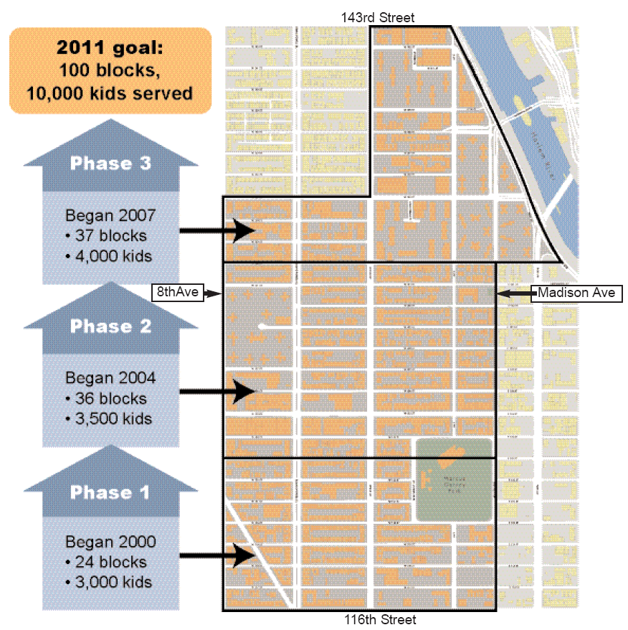
HCZ Project’s Three Growth Phases in Central Harlem
When: 1970’s – Present
Where: Harlem (Over 100 blocks)

Slide 32
Programs offered by HCZ
Baby College
Three Year Old Journey
Target Group: Parents Of Children 0-3.
Baby College is a 9-week Saturday program of workshops and weekly home visits for parents and other caregivers of children aged 0-3. Topics include ages and stages of development, brain development, discipline, safety, health, Administration for Children’s Services (ACS), and nutrition.
Target Group: Three year old children and their parents.
Children who were accepted into Promise Academy via lottery attend the Three Year Old Journey with their parents. Together, they learn about pre-K social and academic expectations and participate in educational activities and trips.

Slide 33
Get Ready for
Pre-K
Harlem Gems
Head Start
Targets: 3-4 year old children
This 6-week summer program is for students who are entering Harlem Gems UPK and Uptown Harlem Gems programs. A master’s level certified teacher, an assistant teacher, and three Peacemakers (college-aged Americorps interns) or teacher’s aides in each classroom educate the seven groups of 20 students. The program begins at 8 am and continues until 4:45 pm.
Targets: 3-4 year old children
Harlem Gems Head Start program features an extended year and extended day program. All students attend from 8 am to 5:45 pm. The rich curriculum is based on High Scope, Creative Curriculum, and Life Skills Learning Approach. Students learn their numbers, days of the week, and other basic vocabulary words in English, Spanish, and French.

Slide 34
Harlem Gems Universal Pre-Kindergarten and Uptown Harlem Gems
Peacemakers
Targets: 3-4 years old children
At two separate locations, one in a public school and the other in a storefront, Harlem Gems prepares four-year-old children for entry into kindergarten. Harlem Gems features an extended day and extended year program.
Targets: Elementary Aged Children
Through this program, college-aged interns offer in-classroom support, supervise transitional periods during the school day, provide after-school programming, and coordinate outreach to parents at seven elementary schools in Harlem.

Slide 35
Promise Academy l & ll
Food Services
Targets: K-12 aged students
HCZ Promise Academy Charter Schools offer a high quality, extended day, extended year education to elementary, middle, and high school students. Strong Academics: A comprehensive college preparatory educational program within an extended school day and school year allows PA to have a strong focus on literacy and math within a safe, structured, and personalized environment. Each school has reading and math coaches and all classrooms are staffed with one lead teacher and a Peacemaker or paraprofessional. More Time on Task: The school day runs from 8 am to 4 pm.
Targets: All ages
HCZ’s Executive Chef has created a food service program that ensures that children in our early childhood programs and charter schools eat healthy, locally grown, varied cuisine that is freshly prepared in HCZ’s kitchens. As young people learn to explore the salad bar and experiment with new foods, they are exposed to healthier options than the junk food so prevalent in their neighborhood. In addition, the food services program sponsors gourmet cooking classes for children and families to demonstrate the relationship between healthy eating and a healthy life.

Slide 36
Harlem Children’s Health Project
HCZ Community Center
Targets: Children age 0-23
Students have year-round access to high quality comprehensive health care, at no cost, regardless of insurance coverage. Health education and promotion programs and activities expand children’s and parents’ knowledge of personal, community, and public health.
Targets: Middle school-adults
The Center offers after-school and weekend programs for young people from middle school through high school. The programs incorporate academic, recreational, and social activities, and all students are prepared to apply to college. Free activities for adults include: aerobics classes, use of the fitness room, martial arts classes, African dance, personal training sessions, Cards and Café Night, gourmet cooking classes, and free tax preparation.

Slide 37
Harlem Children’s Zone Asthma Initiative (HCZAI)
5th Grade Institute
Targets: Children 0-12 years of age
Families with a child who has been diagnosed with asthma are offered free medical, educational, legal, social, and environmental assistance through home visits approximately every three months.
Targets: 5th grade students
The 5th Grade Institute prepares 5th graders for the difficult transition to middle school through academic support, leadership development, and guidance in understanding and accessing middle school options.

Slide 38
A Cut Above
Boys To Men
Targets: 6th grade – college
Extending the supports that the Peacemaker program provided through the 5th grade, A Cut Above begins working with 6th graders and stays with them through college. This creates a parallel pipeline of support for children not in the HCZ Promise Academy schools, offering them academic assistance, leadership development, and job-readiness workshops, as well as high school and college preparation.
Targets: Middle school- high school
Boys to Men is a program exclusively for young males, offered by an all-male team of staff, mentors, and role models, in partnership with fathers and male guardians. The overarching goal is to sustain the interest of this core group through high school and into college.

Slide 39
TRUCE Fitness and Nutrition Center
Healthy Living Initiative
Targets: Middle School Age Children
TFNC offers a free exercise facility to youth and the broader Harlem community. The program promotes academic growth and helps youth develop marketable skills in nutrition, fitness, presentation, and advocacy. Middle school students enrolled in the program become Junior Youth Managers (JYMs). JYMs attend at least three days per week and exercise at least two hours per week.

Slide 40
TRUCE
Employment & Technology Center (ETC)
Targets: High School
TRUCE is a comprehensive leadership program for adolescents. The program promotes academic growth and career readiness using the arts, media literacy, health, and multimedia technology. In addition to creating original media, students must check in with their Student Advocate, who stays on top of their grades, upcoming tests, applications, and other important academic matters.
Targets: High School
Two programs integrate technology and academics: an after-school program for high school youth at risk of dropping out of school and computer classes for adults. Through the lens of technology projects, adolescents advance their academic and job preparation skills with the goal of graduating from high school and applying to college.

Slide 41
Learn To Earn
College Preparation Program
Targets: High School
This after-school program helps high school juniors and seniors improve their academic skills, as well as prepare for college and the job market. Students receive homework help, tutoring, SAT and Regents preparation, summer jobs, and job readiness workshops. Students can earn stipends for their work and attendance.
Targets: Middle School/ High School
To prepare for college, students visit college campuses, draft essays, practice interviewing, and prepare for the SATs. They also meet one-on-one, weekly, with college counselors at each site and can attend a Weekly Senior Seminar where topics such as college preference, career options, financial aid, money management, interview skills, and résumé writing are covered.

Slide 42
Journey to College
College Success Office
Targets: Middle/High School Parents
The Journey to College program helps middle and high school parents nurture and prepare their children for the challenges and opportunities that college and increased independence will bring.
Targets: High School/College Students
College students receive assistance with academic plans, study strategies, workshops, counseling, financial assistance, internships, career readiness activities, and post-graduate opportunities.

Slide 43
Family Support Center (FSC)
Community Pride
Targets: Families
A walk-in, storefront social services facility that provides families in crisis with immediate access to professional social services including foster care prevention, domestic violence workshops, parenting classes, and group and individual counseling.
Targets: Families
This resident-driven, neighborhood revitalization program, which began on W. 119th Street, has led to the creation of community coalitions and the transfer of city-owned buildings to resident management and ownership.

Slide 44
Tax Preparation
Single Stop
Targets: Families
HCZ offers free tax-preparation services. Our tax preparation work helps ensure that families will receive all of the tax refunds and credits they have earned.
Targets: Families
HCZ, Inc. operates three Single Stop sites, including one in the HCZ Project9. At these sites, residents can access free legal services, financial and credit counseling, and a Self- Sufficiency Calculator10 that helps families determine their eligibility for public benefits and then apply for them.

Slide 45
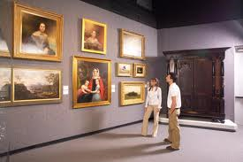
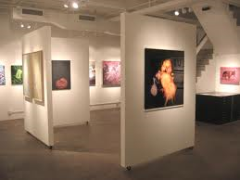
Gallery Walk

Slide 46
Gallery Walk Activity
Take a “Gallery Walk” to each station around the classroom.
Posted at each station is a picture and quote of one of the five major principals of HCZ.
Take time to view each picture/quote and reflect on it’s meaning to you.
Directions:
Leave behind a thought, comment, quote of our own, or personal reflection on the chart paper below each picture.
Time: 10 minutes
Share: 5 minutes

Slide 47
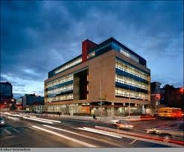
Digger Deeper into Promise Academy
Every morning begins with a recitation of the school motto, including the mantra: "We will go to college. We will succeed. This is our promise. This is our creed."

Slide 48
The school provides an extended school day and year, with coordinated after-school tutoring and additional Saturday classes for children struggling in math or English language arts
Promise Academy I Lower School was created in 2004 in partnership with the Harlem Children's Zone and currently serves grade levels Kindergarten through Fourth.
Promise Academy I Upper Elementary School was created in 2004 in partnership with the Harlem Children's Zone and currently serves grades 5-6.
Promise Academy I Junior High School was created in 2010 in partnership with the Harlem Children's Zone and currently serves grade levels 7 and 8.
Promise Academy I High School was created in 2008 in partnership with the Harlem Children's Zone and currently serves grades 11 and 12.
Promise Academy II was created in 2005 in partnership with the Harlem Children's Zone and the Lower Elementary School currently serves grade levels K through 2.
Promise Academy II was created in 2005 in partnership with the Harlem Children's Zone and the Upper Elementary/Middle School currently serves grade levels 3 through 7.

Slide 49
Enrollment Levels K-12

Slide 50
Students That Attend Promise Academy
Race/Ethnic Origin | 2007-2008 | 2008-2009 | 2009-2010
Black/African American | 91% | 90% | 87%
Hispanic | 9% | 8% | 9%
Other | 0% | 2% | 4%

Slide 51
Eligibility For Free Lunch

Slide 52
Attendance Rate of Students
2006-2007 | 2007-2008 | 2008-2009
90% | 95% | 94%

Slide 53
Grade 3 - % of students at or above proficiency
English Language Arts Test | Promise Academy | State
2010 | 52.7% | 54.7%
2009 | 93.5% | 75.8%
2008 | 68.3% | 70.1%
Math Test | Promise Academy | State
2010 | 55.9% | 59.1%
2009 | 100.0% | 92.9%
2008 | 96.5% | 89.9%

Slide 54
Grade 4 - % of students at or above proficiency
English Promise State Academy
2010 | 40.0% | 56.7%
2009 | 77.1% | 76.9%
Math Test
2010 | 64.2% | 63.8%
2009 | 92.8% | 87.2%
Science Test
2010 | 87.0% | 89.0%
2009 | 83.0% | 88.0%

Slide 55
Grade 5 - % of students at or above proficiency
English Promise State Academy
2010 | 44.4% | 52.5%
2009 | 58.6% | 82.2%
Math Test
2010 | 63.0% | 64.6%
2009 | 72.4% | 88.1%
Social Studies Test
2010 | 79.0% | 86.0%
2009 | 57.0% | 86.0%

Slide 56
Grade 6 - % of students at or above proficiency
English Promise State Academy
2010 | 15.3% | 54.2%
Math Test
2010 | 57.7% | 61.3%

Slide 57
Grade 7 - % of students at or above proficiency
English Promise State Academy
2008 | 52.1% | 70.0%
Math Test
2008 | 83.1% | 78.9%

Slide 58
Grade 8 - % of students at or above proficiency
English Promise State Academy
2009 | 57.6% | 68.5%
2008 | 33.4% | 56.1%
Math Test
2009 | 87.4% | 80.2%
2008 | 97.4% | 69.8%
Science Test
2009 | 61.0% | 69.0%
Social Studies Test
2009 | 20.0% | 63.0%

Slide 59
Teacher Qualifications
School Year | 2007-2008 | 2008-2009 | 2009-2010
Number of Teachers | 47 | 53 | 58
Teachers with no teaching certificate | 19% | 17% | 26%
Teachers teaching out of certification | 19% | 17% | 26%
Teachers with fewer than 3 years experience | 34% | 23% | 24%
Teachers with a masters or above | 15% | 15% | 21%

Slide 60
Survey
Parents
Teachers
Students
2010-2011 School Year | Out of 10
Academic Expectations | 8.1
Communication | 7.3
Engagement | 7.8
Safety/Respect | 7.7

Slide 61
Future Implementation
MANHATTAN — Harlem Children’s Zone got another round of accolades yesterday, this time getting tapped by the federal government to become the model for 20 other areas around the nation, according to reports.
The massive school complex, which covers the span from a “baby university” to teach pregnant parents about child rearing to college prep programs, has been hailed as the future of education, including by President Barack Obama.
Now the government is putting its money where its mouth is, doling out $500,000 grants to other agencies seeking to replicate Harlem Children’s Zone success, according to the New York Post.
The Obama administration has reportedly asked for $200 million in the 2011 federal budget to give to 21 new projects, with an extra $10 million to follow.
Some of the recipients of the funds include local agencies like the Abyssinian Development Corp., which is set to build an educational program in central Harlem, as well as a program in Brooklyn, according to the Post.
Harlem Children’s Zone CEO Geoffrey Canada is expected to walk the red carpet at tonight’s premiere of the new documentary “Waiting for Superman,” which chronicles his journey through the education system.

Slide 62
Critique of the Program
Within framework of Multicultural Social Justice Education, equity and justice are central themes. However, as Sleeter and Grant (2009) have noted, “The notions of equity and justice point to not just a goal of equal opportunity, but also to one of equal results for diverse communities”.
Although Harlem Children’s Zone does not cover all of the school goals represented by Multicultural Social Justice Education, or at least are not publishing information where it can be evidenced, they are incorporating several aspects.

Slide 63
Critique of the Program Continued
One aspect is that Harlem Children’s Zone does promote equal opportunity in the school. The school offers a number of programs at several times, allowing each student the opportunity to get what they need for success.
As mentioned earlier, each student is afforded technology, and ability to participate in trips, regardless of their ability to pay for it.
They also teach empowerment skills to their students and offer programs that provide skills they will need in the workforce. The curriculum also encourages the students to be self-advocates and build on each student’s learning style and promote instruction geared toward meeting a student where they are as well as promoting critical thinking skills needed for student success.

Slide 64
Critique of the Program Continued
Due to the lack of diversity in the schools with this model, it is not clear whether these schools are promoting learning from alternative viewpoints and different U.S. groups or if they are working to understand current social issues that target groups with little representation in the school.
There is potential for these aspects of Multicultural Social Justice Education to be clearly implemented in this model as this becomes a focus for the school.

Slide 65
Critique of the Program Continued
Due to the lack of diversity in the schools with this model, it is not clear whether these schools are promoting learning from alternative viewpoints and different U.S. groups or if they are working to understand current social issues that target groups with little representation in the school.
There is potential for these aspects of Multicultural Social Justice Education to be clearly implemented in this model as this becomes a focus for the school.

Slide 66
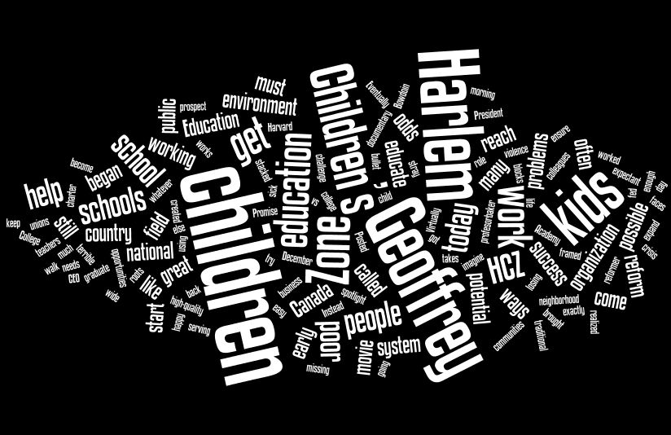

Slide 67
Reference Page
http://www.dnainfo.com/20100922/harlem/harlem-childrens-zone-tapped-as-model-for-programs-around-nation
http://www.hcz.org/
http://schools.nyc.gov/SchoolPortals/05/M284/AboutUs/Statistics/default.htm
http://www.hoyleton.org/images/HCZ_Final_White_Paper.pdf
http://pt3.nl.edu/paquetteryanwebquest.pdf
Banks, J.A. (2004) Multicultural Education: Historical development, dimensions, and practice. Review of Research in Education. 19,3

