Slide 1
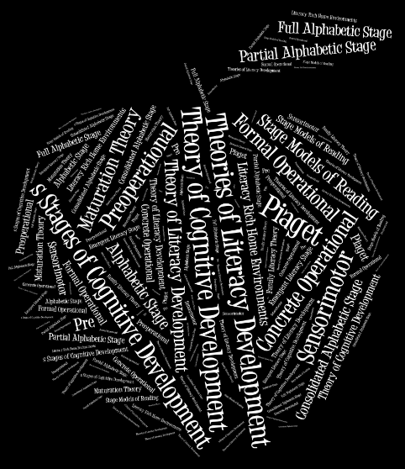

Slide 2
Theories of Literacy Development
1930s – Present Day
Elizabeth Godwin, Brenda Herb,
Amanda Ricketts, Shannon Wymer
ECI 545: Spring 2013

Slide 3
Questions to Guide Our Learning
What is the Theory of Cognitive Development?
What is Maturation Theory?
What is the Theory of Literacy Development?
What are the Stage Models of Reading?
What is Emergent Literacy Theory?
What is Family Literacy Theory
And, how are these theories reflected in reading instruction AND reading research?

Slide 4
Introduction Activity
Theories of Literacy Development Concept Sort
Please click on the following link to complete the sort.
Interactive Concept Sort
Please use the e – mail address skwymer@ncsu.edu when you are prompted.

Slide 5
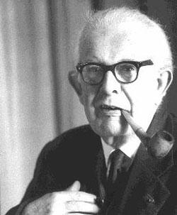
Theory of Cognitive Development
Jean Piaget: 1969
Presenter: Brenda Herb

Slide 6
Theory of Cognitive Development
One of the most famous theories used to explain children’s overall cognitive development.
It can be used by literacy educators to understand the learning stages through which students progress as they mature and their relationship to literacy achievement.

Slide 7
Four Stages of Cognitive Development
Piaget describes four stages of Cognitive Development:
    Sensorimotor: Birth – 2 Years of Age
    Preoperational: 2 Years of Age – 7 Years of Age
    Concrete Operational: 7 Years of Age – 11 Years of Age
    Formal Operational: 11 Years of Age - Adult

Slide 8

Sensorimotor:
Birth – 2 Years of Age
Sensory exploration of the world: Children do not have language skills and are dependent on their senses.
Activities for Literacy
  Board books with brightly colored pictures
  Books with sound, things to touch, or smell

Slide 9

Preoperational:
2 Years – 7 Years of Age
This stage is categorized with rapid language development. Children begin to categorize with words.
Activities for Literacy
  Story book reading and discussing the story

Slide 10
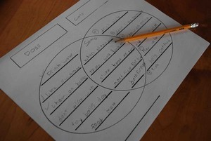
Concrete Operational:
7 Years – 11 Years of Age
In this stage of development, children use concrete objects to begin to think about abstract concepts.
Activities for Literacy
  Graphic Organizers {Venn Diagrams, Flow Maps}

Slide 11
Formal Operational:
11 Years of Age - Adult
In this stage, children use language in an abstract way.
Activities for Literacy
  The use of metacognitive reading strategies helps students to “think about their thinking” before and after they read.
      Examples: Making Inferences, Summarizing

Slide 12
Maturation Theory
Morphett & Washburne: 1931
Presenter: Shannon Wymer

Slide 13
Maturation Theory
Morphett and Washburne proposed the theory in 1931 to advocate for not teaching reading until children were mature enough for instruction.
They hypothesized that this could happen when children were a mental age of 6 1/2.
This theory impacted reading instruction until the mid-1950s. The theory has since been proven incorrect and ineffectual.
The idea of maturation still has impact on reading theory, but the idea of a specific age is no longer a part of reading instruction.

Slide 14
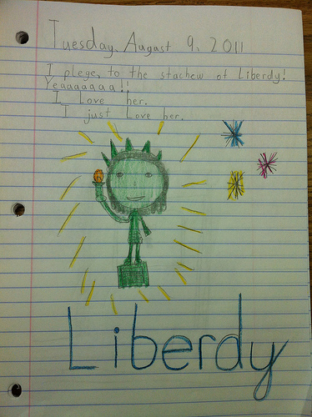
Maturation Theory
Activities for Literacy
  Unfortunately, there are really none!
  The text makes a slim connection to invented spelling, however, we have learned that invented spelling is rooted in other theories of development and learning.
  Invented Spelling Video

Slide 15
Theory of Literacy Development
Holdaway: 1979
Presenter: Amanda Ricketts

Slide 16
Theory of Literacy Development
Holdaway believed that learning to read was a natural development that is closely linked to a child’s natural development of oral language skills.
There are four key components to this theory:
  Observation
  Collaboration
  Practice
  Performance

Slide 17
Key Components
Observation
Children need the opportunity to observe literacy behaviors from others. For example, being read to from a parent.
Collaboration
Children need to interact with others who provide encouragement and help with the reading process.
Practice
Children need the opportunity to practice alone in order to self evaluate, make corrections, and increase their skills independently.
Performance
Children need the opportunity to share their new reading skills with those who support them.

Slide 18
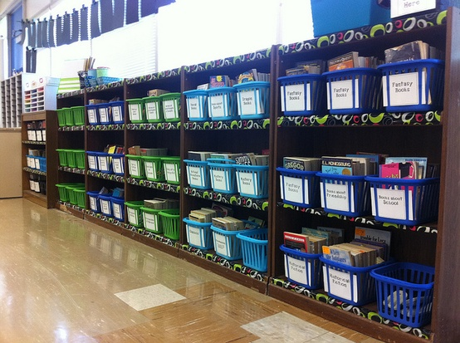
Characteristics that Facilitate Natural Literacy Development
Rich home literacy environment
Parent – Child interactions of modeling literacy behaviors
Rich literacy classroom environment
  Labeling key items around the room
  Wide variety of high quality reading materials
  Meaningful language experiences
  Use of big books and shared reading

Slide 19
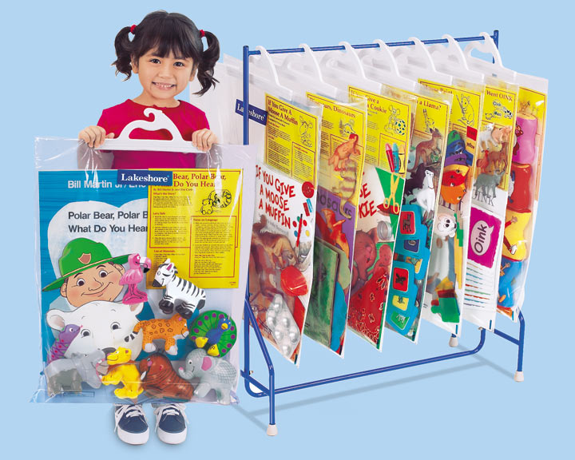
Big Books
Holdaway highly recommends the use of big books and shared reading to foster natural literacy development.
He believes big books can create the same positive feelings about story time that children have when they read at home.
He believes that these natural storytelling times build student’s oral language, print tracking, concept of letters, and words.
Shared Reading Video

Slide 21
Stage Models of Reading
Chall: 1983
Frith: 1985
Ehri: 1991
Gough, Juel, and Griffith: 1992
Presenter: Amanda Ricketts

Slide 22
Stage of Models of Reading
Reading development stages have been proposed by Chall (1983), Frith (1985), Ehri (1991), and Gough, Joel & Griffith (1992).
Stage Model theorists believe lower staged reading strategies remain available to a reader as they incorporate more difficult reading skills in later strategies.
Stages are provided to have a better understanding of the reading process.
Stage Model theorists believe students increase the number of strategies used during reading as their reading skills develop.

Slide 23






Four Stages of Word Identification
Pre – Alphabetic Stage {Logographic Stage}
  Visual cues are primary method of word identification
  One might memorize words by their shape or “look”
  Use of environmental print and logos
  Word Identification is not yet related to letter – sound knowledge
Activities for Literacy
  Collect samples of Environmental Print to display in the classroom.

Slide 24
Four Stages of Word Identification
Partial Alphabetic Stage
  “Phonetic Cue Reading”
    Use of some letter – sound cues
      First letter of the word
      Use just a letter or two
Full Alphabetic Stage
  Student relies more on letter – sound knowledge
  Student tries to process all the letters in a word
  Child may become tied to letter-by-letter reading which slows down the reading process
Activities for Literacy
  Puzzles, Word Card Games, Magnetic Letters, Alphabet Books
  Magazine Search, Letter Bingo
  Word Sort: Beginning, Middle, and End Sounds
    Alphabet Bingo: ABCya!

Slide 25
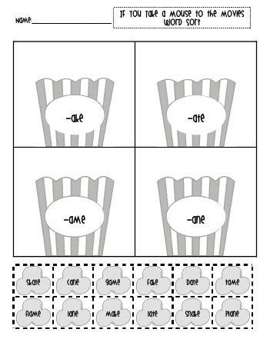
Four Stages of Word Identification
Consolidated Alphabetic Stage
  Automatic knowledge of sound – letter relationships
  Read letter patterns within words
  Use word family knowledge to aid the reading process
Activities for Literacy
  Word Wheels, Word Family Sorts, Poetry, Flip Books

Slide 26
Emergent Literacy Theory
Morrow: 2001, 2005, 2012
Presenter: Elizabeth Godwin

Slide 27
Emergent Literacy Theory
Emergent Literacy Theory explains early literacy development and provides educators with instructional guidance to promote early literacy growth among their students.
“Emergent Literacy” refers to a period in a child’s life between birth and when the child can read and write at a conventional level (p.99).

Slide 28
Emergent Literacy Theory: Number One
Theorists believe that children’s development in the areas of listening, speaking, reading, and writing are all interrelated.
Because of this, it is clear that positive growth in one area of literacy development will have a positive effect on the other areas of development.

Slide 29

Emergent Literacy Theory: Two
Theorists believe that literacy development starts at birth and is continuous and ongoing.
Contrasts to Other Theories
  Maturation Theory
  Stage Models of Reading
  Why? Because children’s earliest experiences of being talked to and read to are essential components of their early reading development.

Slide 30
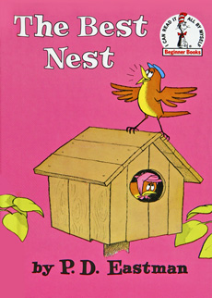
Emergent Literacy Theory: Three
Because Emergent Literacy Theorists believe that children’s listening, speaking, reading, and writing skills begin at birth, it also emphasizes the importance of a literacy rich home environment.
Components of a literacy rich home environment
  Large number of books available
  Newspapers and Magazines
  Parents read a variety of materials
  Reading is associated with pleasure
  Parents frequently read to children
Think – Pair - Share: Can you remember your first experience with books?

Slide 31
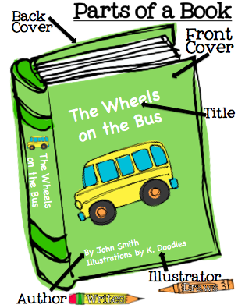
Essential Understandings: Gunning
There are a number of essential understandings that children need to acquire during the Emergent Literacy Phase of development.
  Concepts About Print
    Examples
      A book is read from front to back.
      A book has a title, author, and sometimes an illustrator.
      Sentences end with periods, question marks, or exclamation marks.

Slide 32
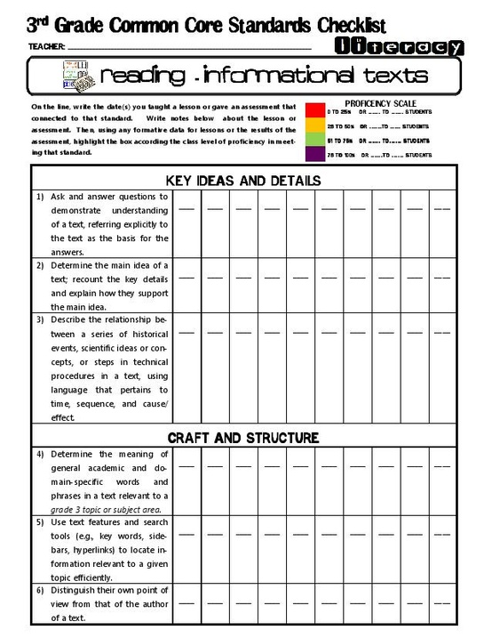
Emergent Literacy:
Classroom Applications
Multiple Assessment Tools to Track Literacy Growth
  Data Binder
Thematic Instruction
Use of High – Quality Children’s Literature
Literacy Centers
  Debbie Diller
  Resource: FCRR
    Multiple Meanings Example

Slide 33
Family Literacy Theory
Taylor: 1983
Presenter: Shannon Wymer

Slide 34
Family Literacy Theory
Refers to a series of ideas that researchers share, including the design, implementation, and evaluation of programs to help facilitate literacy development of family members; the relationship between family literacy and student achievement; and the ways in which literacy is naturally used in the home.
This theory stresses the importance of family involvement on student achievement.

Slide 35
A Note for School Administrators
Three Actions to Encourage Family Literacy
  Create a two – way street between parents and teachers in order to gain information about literacy in the home.
  Teach parents about the school culture and necessary skills for a student to be successful.
  Help parents understand what they can do at home to help support and encourage their children’s academic success.
      Many studies have been done on parent and child reading interactions to support the importance of the connection between home and school.

Slide 36

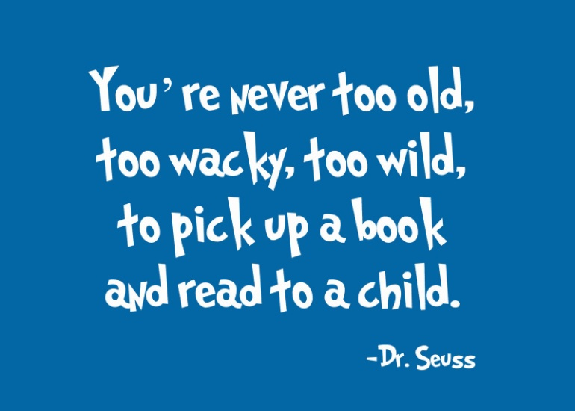
Encouraging Family Literacy in the Classroom
Parent Volunteers Reading in the Classroom
Family Information Nights
  Literacy Focus
Family Reading Challenges

Slide 37
So, what is the BIG picture?
Timeline: Tiki - Toki

Slide 38
What have YOU learned?
Let’s go on a Gallery Walk!
  In your group, you will identify what you have learned about the five Theories of Literacy Development. We have left out the Maturation Theory for this activity.
Your Task: 3, 2, 1!
  Identify THREE things that you learned, TWO ways that you incorporate the specific theory in your classroom, and ONE question that you still have.
  Have fun!

Slide 39
Let’s take another look…
Please reference the Concept Sort that you completed as a introduction activity prior to our presentation.
Ask yourself:
  Are there any activities that I need to change?
  What are the common themes between the activities and the theories?

Slide 40
More Information
If you would like to learn more information about the Theories of Literacy Development, please reference the following articles or websites.
  Ehri’s Stages
    Developmental Steps in Learning to Read: A Longitudinal Study in Kindergarten and First Grade
      Source: Reading Research Quarterly
  Concepts About Print
    Activities to Teach Concepts About Print

